Slide 1

Code Marathon
R2P Platform
Victor & Barbara
Notes:
Welcome to join this session. We are from DevFins team, I am Victor, her name is Barbara.
DevFins means Development and Finance.
Our case is from AO department for payment process issue.

Slide 2
Agenda
Current business workflow
New design
Performance improvement

Slide 3


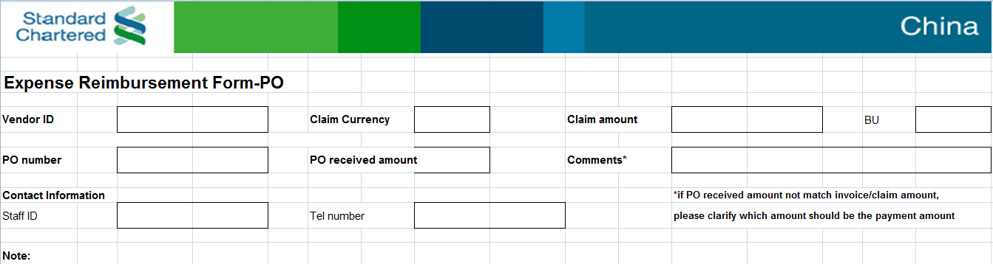
Current Business Workflow
AO
Requestor
Notes:
In this case, our user is from AO department, their job is payment. Currently, they always manual to input invoice information and verify it within BRCC data. BRCC can be considered as SCB internal invoice data from different city. Now we have almost 28 cities BU.
Requester must fill in payment excel and then print it out. And then post it to AO within the invoice. For example, you have business travel to SG, when you are back, you have to fill in the payment excel and then post your hotel invoice, and submit to your HR. and HR will help you transfer to AO.
AO staff will register this invoice information into system and then trigger to verify it with BRCC data.
For verification invoice, AO staff will scan the invoice for backup and transfer it to Indexer Department.
AO staff will send email to BRCC, and tell them which invoice is verified, which one is not.
Requester must fill in payment excel and then print it out. And then post it to AO within the invoice. For example, you have business travel to SG, when you are back, you have to fill in the payment excel and then post your hotel invoice, and submit to your HR. and HR will help you transfer to AO.

Slide 4

Current Business Workflow
AO
Indexor
Register Invoice
Verify By BRCC
Scan Invoice
BRCC
feedback
Notes:
AO staff will register this invoice information into system and then trigger to verify it with BRCC data.
For verification invoice, AO staff will scan the invoice for backup and transfer it to Indexer Department.
AO staff will send email to BRCC, and tell them which invoice is verified, which one is not.

Slide 5
Current Business Workflow
BRCC-28 cities
BRCC-TJ
BRCC-BJ
AO-Department
SCB OE system
BRCC-SH
......................
BRCC-SZ

Slide 6
Current Business Workflow
In above description, the draft estimation is that:
Manual register: 25s * 2000 / month
Manual scan : 3s * 3 * 2000 / month
Communicate with BRCC : 7 hour / month
Manual mistake : 3%
Notes:
AO staff will register this invoice information into system and then trigger to verify it with BRCC data.
For verification invoice, AO staff will scan the invoice for backup and transfer it to Indexer Department.
AO staff will send email to BRCC, and tell them which invoice is verified, which one is not.

Slide 7
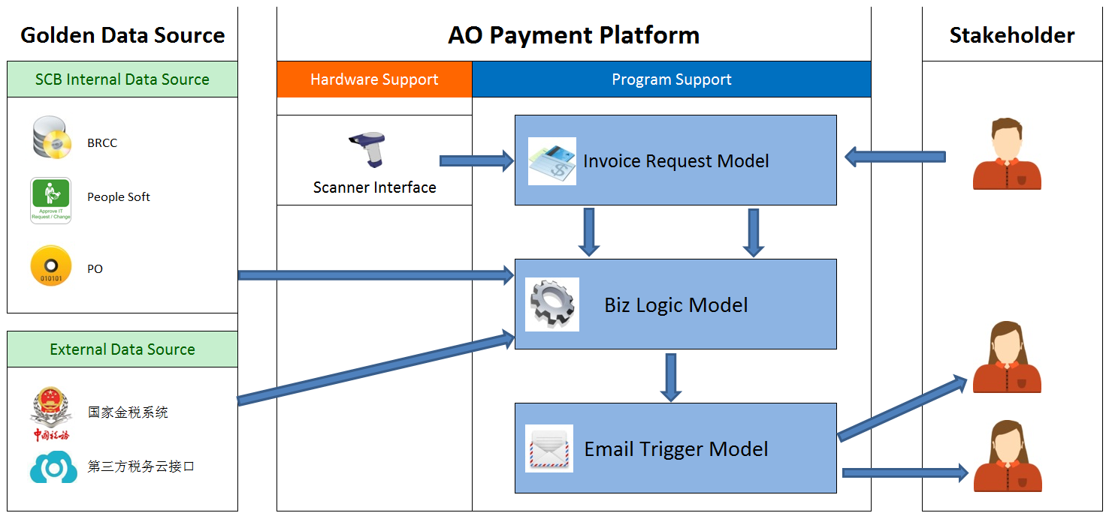
New Design

Slide 8
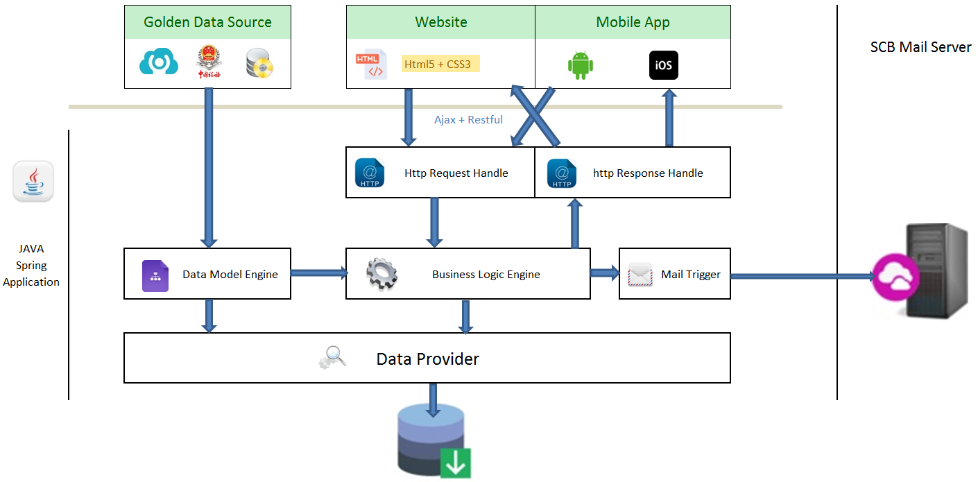
New Design

Slide 9
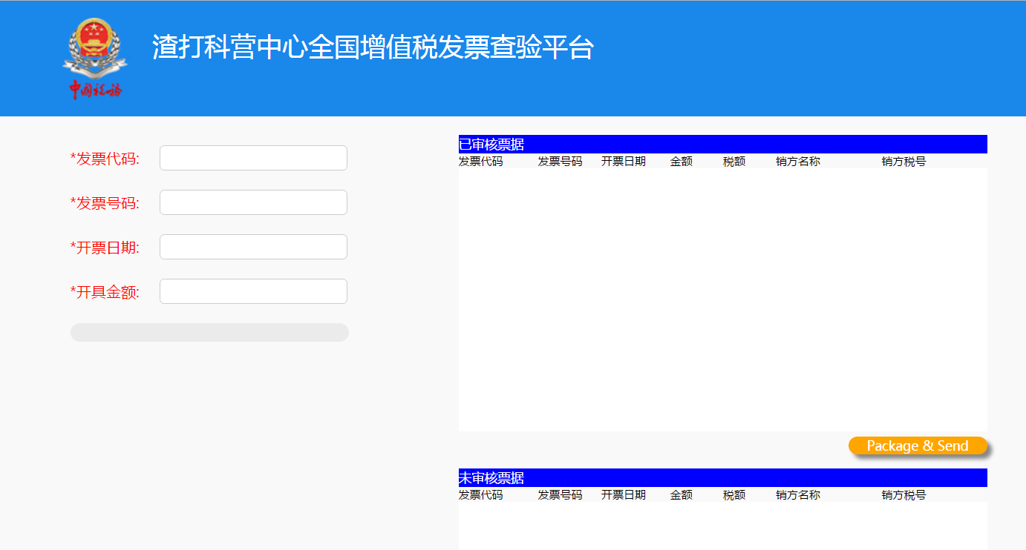
Demo

Slide 10
Q&A

